Slide 1
Intro to Python
By Jessica Garson

Slide 2
Set up
To get online make sure you are on the Arlington public library’s network
Slides and other class resources can be found here: https://github.com/JessicaGarson/PythonClass
My twitter handle is @jessicagarson – please tweet at me

Slide 3
A note on this class
We are going to attempt to create a working blog by the end of today’s class
We are also going to make a text based game
This is a lot of material and we might not accomplish all of it today and that’s okay

Slide 4

My story

Slide 5
Introductions – Turn to someone you don’t know and ask as follows
Your name
Favorite movie
What brings you here today

Slide 6
Why Python?
It’s flexible enough to be used to create websites, do automation tasks, and be used a statistical package. It’s a great beginner language.

Slide 7
About this class
There will be two parts of today’s class. Part one will focus on building our fundamentals. In part 2 we will make some internet happen.

Slide 8
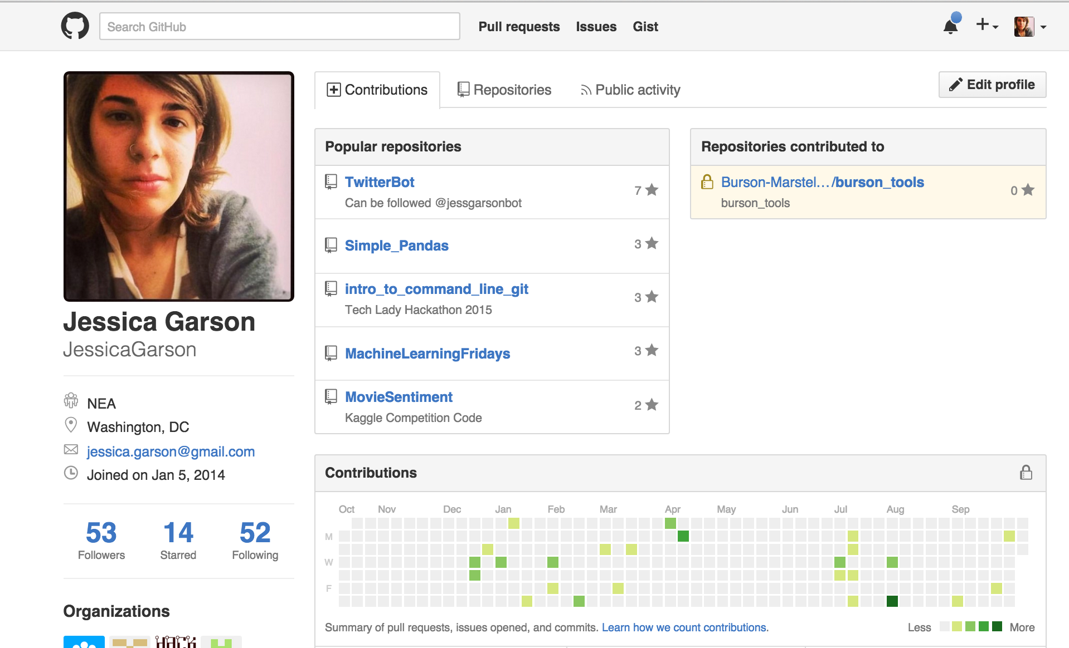
Let’s make our own github profile www.github.com

Slide 9
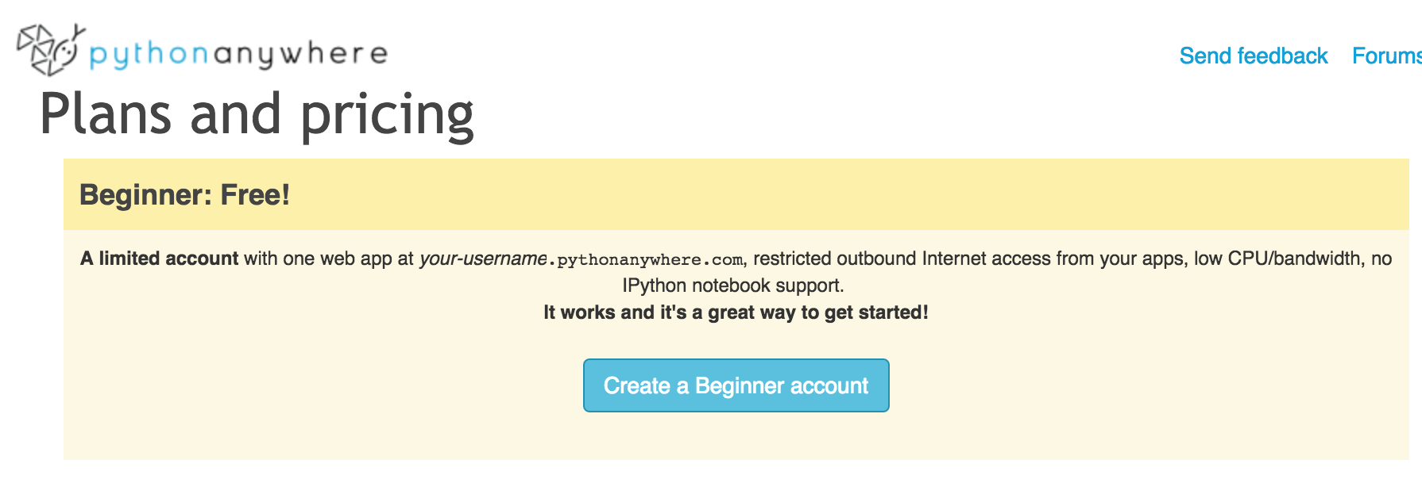
Let’s create a beginner account on pythonanywhere.com

Slide 10
Part 1
Python Basics

Slide 11
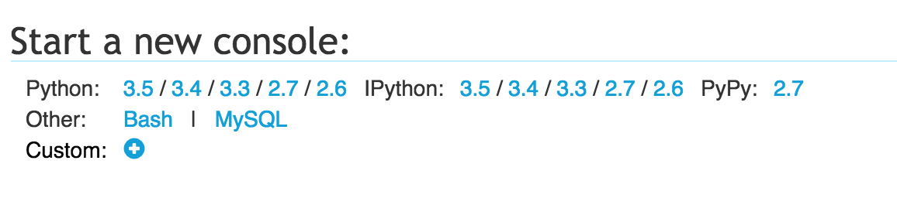
For this section start python 2.7 console

Slide 12
Strings
Strings are a way to store information
Strings have quotes around them and there are 2 different options for how to use them
"This is a string"
'This is also a string'

Slide 13
Variables
Variables are containers for information; you can store text, numbers, or any other type of thing!
name = “Jessica Garson”
age = 31

Slide 14
Print
Use the print command tells python what it will display
print age
print name

Slide 15
Let’s make some mistakes
print “hello friend’
Print “yo what’s up”
print hello

Slide 16
String formatting
You can format your string to make it relevant to the task you have at hand
“Hello {0}, you are {1} years old”.format(name, age)

Slide 17
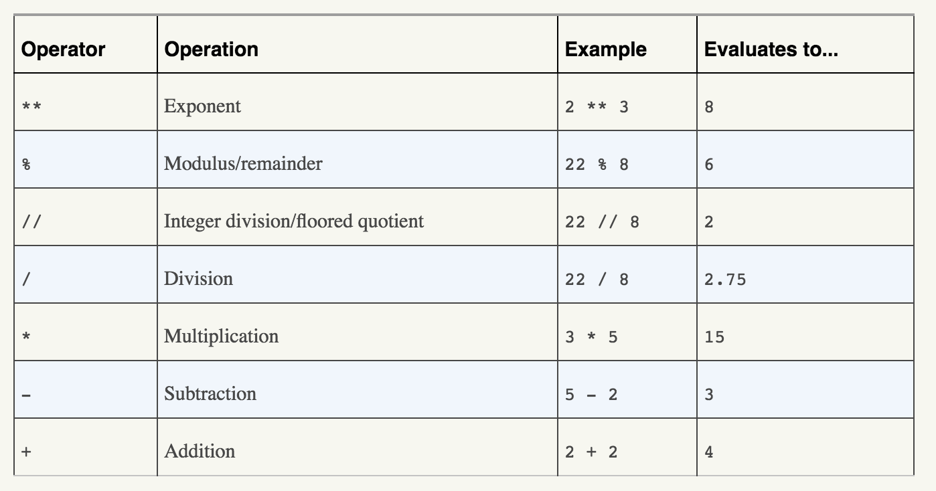
Math Operators
From Automate the Boring Stuff with Python

Slide 18
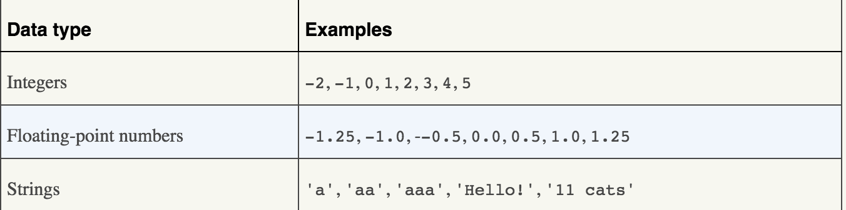
Data types
From Automate the Boring Stuff with Python

Slide 19
You can convert into each of the data types
age = 31
string_age = str(age)
int_age = int(string_age)
float_age = float(age)

Slide 20
Let’s try some math!
2 + 3
3 * 5
66 / 3

Slide 21
Slicing
Python starts count at zero and you can use slicing to get chunks
Let’s create a variable called python in it that contains the string python
python[0]
python[3]
python[2:]
python[:3]
python[2:5]
P | Y | T | H | O | N
0 | 1 | 2 | 3 | 4 | 5

Slide 22
Operators
These are ways to compare two things:
== These two things are equal
!= NOT! equal to
> Greater than
< Less than
>= Greater than or equal to
<= Less than or equal to
Let’s test this out together
4 == 3
2 > 1

Slide 23
Conditionals
if – is a condition tells the program to do something
elif – allows you to have another condition tells the program to do something else
else – if none of the conditions meet the program will do another thing
if class_members == 10:
print “Yay”
elif class_members < class_computers:
print “We might need some more computers”
else:
print “I’m really looking forward to this class”

Slide 24
Functions
Functions allow you to divide your code into reusable chunks
def greet(name):
return "hello "+name
greet_someone = greet
print greet_someone(”Jess")

Slide 25
Lists
If you have more than one of item that you want to contain in a variable (ex. student1, student2, student3) it would be annoying to write out variables for each of them.
Lists are containers that can hold multiple pieces of information. Lists are commonly used to hold strings and numbers.
We can also slice lists in the same way we did earlier in the class
attendees = [’Jess', ’Greg', 'Grace']
attendees.append(‘Chelsea’) -adds one to the end
attendees.extend(‘Tyson’, ‘Steve’)-adds many to the end

Slide 26
Dictionaries
Dictionaries are another way of storing information in Python. Dictionaries have two components: a key and its corresponding value. This is really great for storing information that has more than one value such twitter handles and students.
student_twitter = {‘jess’: ‘jessicagarson’, ‘bob’: ‘bobsmith’, ‘lakia’: ’lakiajones’}

Slide 27
For Loops
days_of_week = ['Monday','Tuesday’, ‘Wednesday’]
for day in days_of_week: print day
For each item in this list:
do something with that item

Slide 28
While Loops
A for loop lets you use each item in a single list one at a time, which is great for performing actions a certain number of times. While loops are the cousins of conditionals.
if students >= 2:
print "I'm glad I’m not lonely in this class"

Slide 29
Libraries
Libraries are pre-made code that help you accomplish different goals.
To install libraries in python you would do the following:
pip install requests
At the top of your code you would use the following syntax
import requests

Slide 30
Prompting People using Raw Input
name = raw_input(“What’s your name? )“
age = raw_input("How old are you? ")
color = raw_input(”What’s your favorite color? ")

Slide 31
How to run a program
Let’s create a program that prints “hello world”
To run this program you can go into your terminal and type the following
python helloworld.py

Slide 32
Creating a text based game
You have 15 minutes to create a text based game based on what we just learned
If you don’t know where to start check out the example in my repository

Slide 33
Show and Tell
Let’s break into groups and show each other our games

Slide 34
Part 2
Creating a site with Flask

Slide 35
What is Flask?
Flask is a web platform for python . It allows you to quickly create sites with not a lot of set up.

Slide 36
What about Django?
Flask is a "microframework" primarily aimed at small applications with simpler requirement while django is a bit better for larger applications.
Flask allows you to choose a database and django has one out of the box.

Slide 37
Let’s set up our flask app
Go to the tab where it says web
Set up a flask app using python 2.7

Slide 38
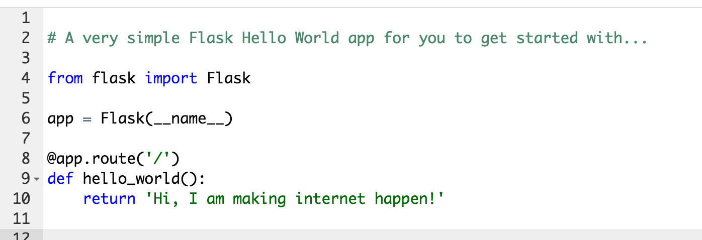
Edit your app to say something different from the default

Slide 39
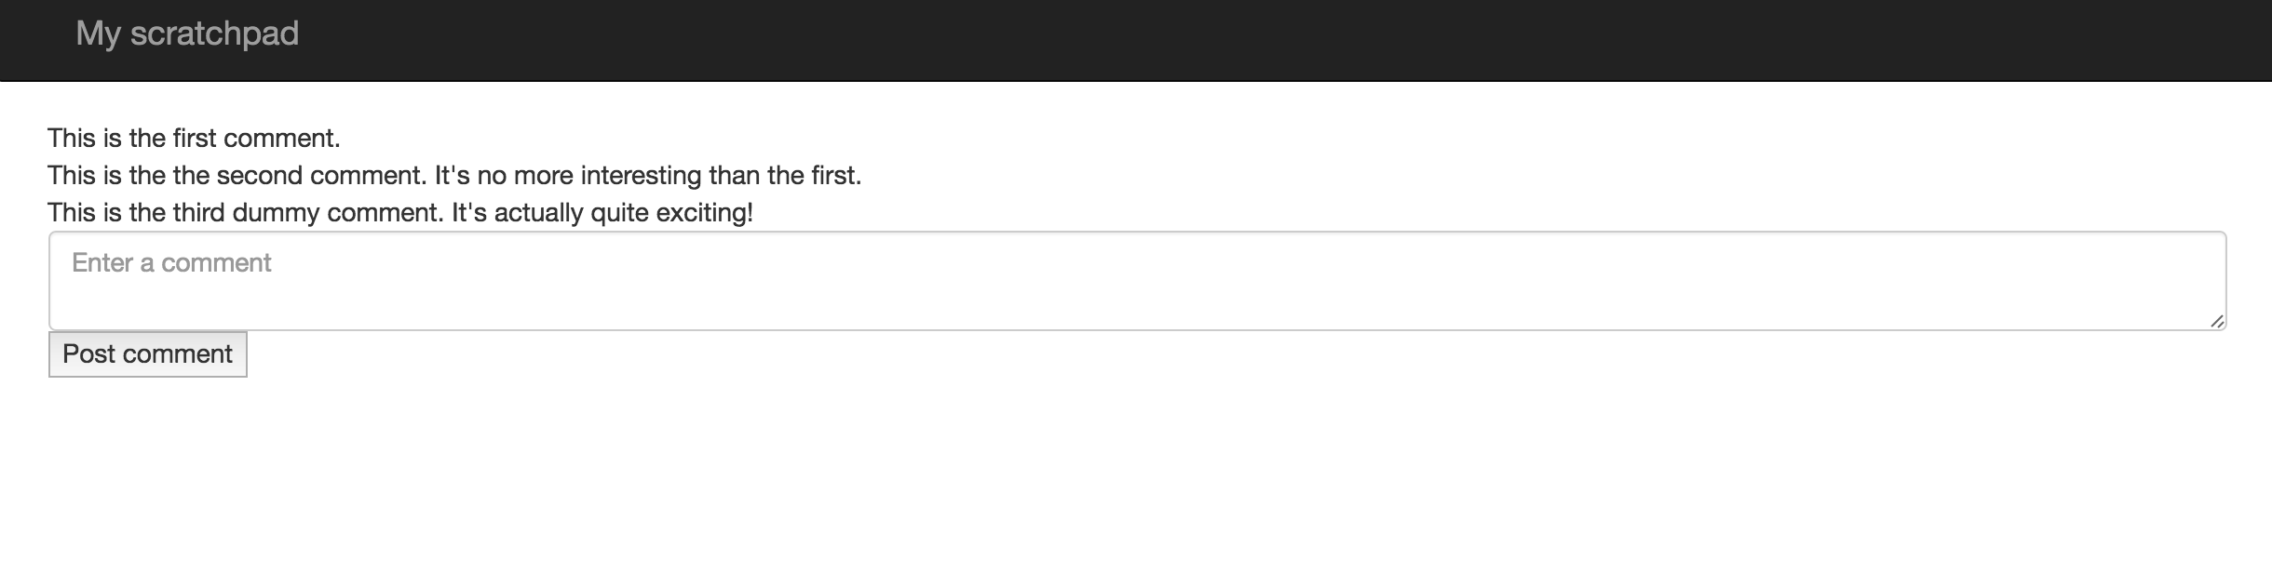
Let’s create an app that looks like this

Slide 40
Conclusion

Slide 41
Do This at Home
Shell Environments
On a mac – there is a Linux environment that comes pre-installed called the terminal
To get to the terminal go to finder select utilities and inside the folder you should
On a PC – There are many options but I really like babun - http://babun.github.io/
Text Editors
Sublime Text - http://www.sublimetext.com/
Atom - https://atom.io/
Notepad ++ for PC only - https://notepad-plus-plus.org/

Slide 42
Installing Python on your Computer – Macs
Python comes bundled with Macs already, so there's no extra setup for now. You'll want to check which version you have, but it's not super important for writing your first scripts.

Slide 43
Anaconda
If you are looking to do more math, science and data work you will want to download the anaconda package of python.
https://www.continuum.io/downloads

Slide 44
Installing Python on your Computer – PC and Linux
Running Python in Windows or Linux
Download and install Python from here: http://www.python.org/download/releases/2.7.6/
I prefer to use IDLE (bundled with Python) over the command prompt when possible -- simply put, it's easier to use. If you need to run Python scripts from the command line, the Mac instructions below will work with minimal adjustment.
When you run IDLE, you'll automatically be in the interactive interpreter mode where you can run Python commands one at a time.
To create a new file from IDLE, go to File > New Window. A new, blank screen will open up where you can create your Python projects.
When you have a Python file open in IDLE, you can run it at any time by pressing F5.

Slide 45
Resources for Learning Flask
The offical flask tutorial - http://flask.pocoo.org/docs/0.10/tutorial/
Mega flask tutorial - http://blog.miguelgrinberg.com/post/the-flask-mega-tutorial-part-i-hello-world

Slide 46






The coolest thing about DC right now

Slide 47
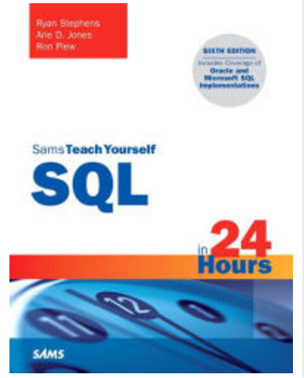
A few resources I recommend

Slide 48
See you around
I’m a co-organizer for hack and tell - http://www.meetup.com/DC-Hack-and-Tell/
I’m planning the Tech Lady Hackathon this year - http://techladyhackathon.org/
I help out with Hear me Code - http://hearmecode.com/
I also have a zine that can be found here – bit.ly/whatsmyfunctionzine

Slide 49
Contact
Jessica Garson
Jessica.Garson@gmail.com
Jessica.Garson@bm.com
Twitter: @jessicagarson

